Slide 1
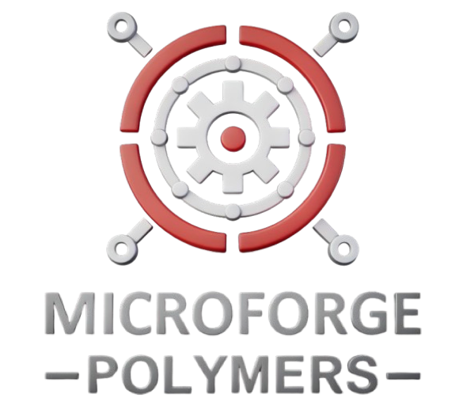
THE SOLUTION
Two Groundbreaking Technologies
New Micro-Injection Molding Technology
New Precision Bonding Technology
Patent-pending vacuum-assisted filling
Low pressure (100-150 vs. 1,000-2,000 bar)
Precise thermal control (±0.1°C)
Zero warping, minimal shrinkage
Ultra-precise alignment (±5μm)
Irreversible molecular bonding
No adhesives needed
Multi-material capability
Patent-Pending Breakthrough Technology
Vacuum-assisted injection molding at 150 bar vs traditional 1,500 bar
Complete ground-up redesign enabling impossible precision manufacturing

